Slide 1
Organizational
Structure & Design
Management by Robbins & Coulter, Chapter 10 & 11 (11th Edition)

Slide 2
What Is An Organization?
A deliberate arrangement of people to accomplish some specific purpose (that individuals independently could not accomplish)
Common characteristics of organizations
Have a distinct purpose (goal)
Composed of people
Have a deliberate structure

Slide 3
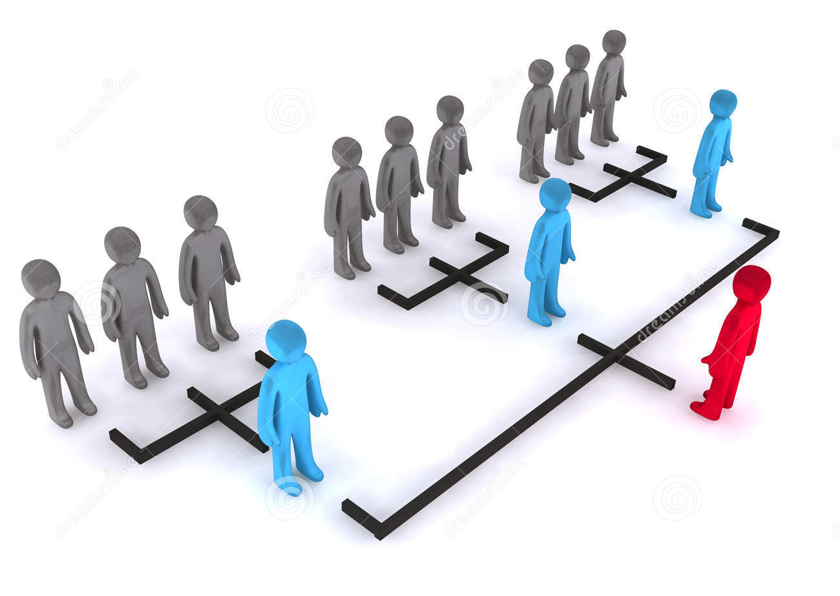
Organizational Structure
The formal arrangement of jobs within an organization.

Slide 4
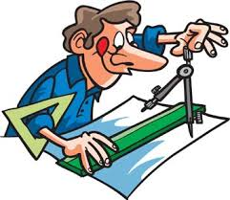
Organizational Design
A process involving decisions about six key elements:
Work specialization
Departmentalization
Chain of command
Span of control
Centralization and decentralization
Formalization

Slide 5
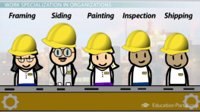
Work Specialization
The degree to which tasks in the organization are divided into separate jobs with each step completed by a different person.

Slide 6
Work Specialization
Overspecialization can result in human diseconomies from boredom, fatigue, stress, poor quality and increased absenteeism.

Slide 7



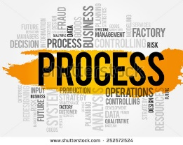

Departmentalization
Functional
Grouping jobs by functions performed
Product
Grouping jobs by product line
Geographical
Grouping jobs on the basis of territory or geography
Process
Grouping jobs on the basis of product or customer flow
Customer
Grouping jobs by type of customer and needs

Slide 8
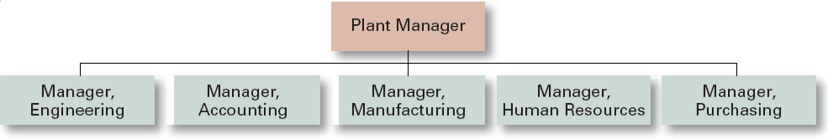
Functional Departmentalization
+ Efficiencies from putting together similar specialties and people with common skills, knowledge, and orientations
+ Coordination within functional area
+ In-depth specialization
– Poor communication across functional areas
– Limited view of organizational goals

Slide 9
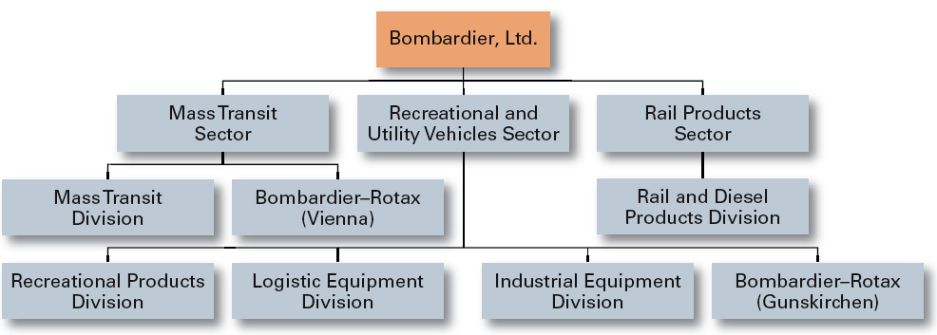
Product Departmentalization
+ Allows specialization in particular products and services
+ Managers can become experts in their industry
+ Closer to customers
– Duplication of functions
– Limited view of organizational goals

Slide 10
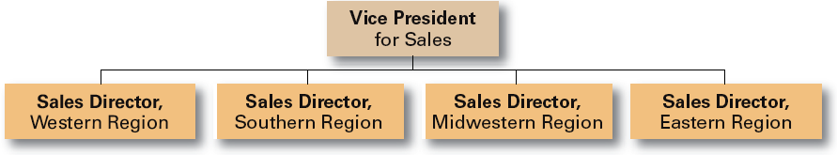
Geographical Departmentalization
+ More effective and efficient handling of specific regional issues that arise
+ Serve needs of unique geographic markets better
– Duplication of functions
– Can feel isolated from other organizational areas

Slide 11
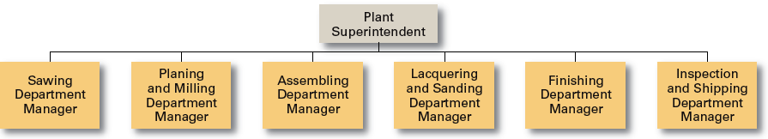
Process Departmentalization
+ More efficient flow of work activities
– Can only be used with certain types of products

Slide 12
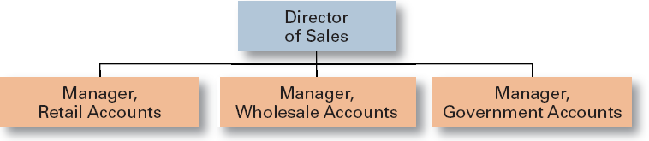
Customer Departmentalization
+ Customers’ needs and problems can be met by specialists
– Duplication of functions
– Limited view of organizational goals

Slide 13
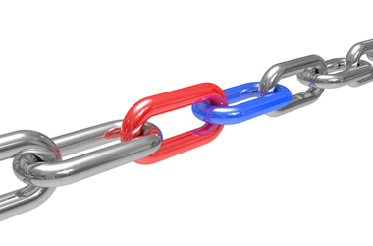
Chain of Command
The continuous line of authority extends from the upper levels of an organization to the lowest levels of the organization and clarifies who reports to whom.

Slide 14
Span of Control
The number of employees who can be effectively and efficiently supervised by a manager.
Width of span is affected by:
Skills and abilities of the manager
Employee characteristics
Characteristics of the work being done
Similarity of tasks
Complexity of tasks
Physical proximity of subordinates
Standardization of tasks

Slide 15
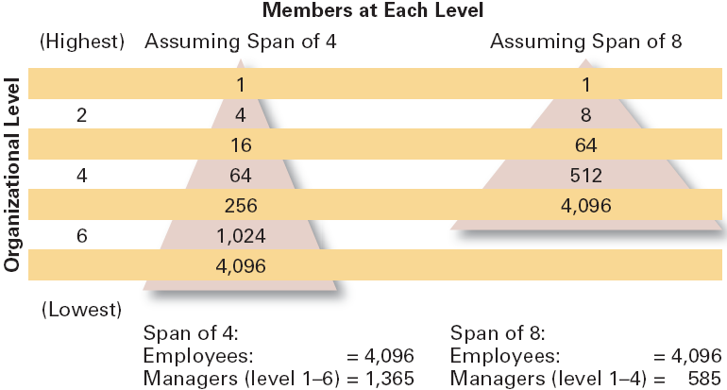
Contrasting Spans of Control

Slide 16
Centralization & Decentralization
Centralization
The degree to which decision-making is concentrated at a single point in the organizations.
Organizations in which top managers make all the decisions and lower-level employees simply carry out those orders.
Decentralization
Organizations in which decision-making is pushed down to the managers who are closest to the action.

Slide 17
Factors that Influence the Amount of Centralization
More Centralization
Environment is stable.
Lower-level managers are not as capable or experienced at making decisions as upper-level managers.
Lower-level managers do not want to have a say in decisions.
Decisions are relatively minor.
Organization is facing a crisis or the risk of company failure.
Company is large.

Slide 18
Factors that Influence the Amount of Decentralization
More Decentralization
Environment is complex, uncertain.
Lower-level managers are capable and experienced at making decisions.
Lower-level managers want a voice in decisions.
Decisions are significant.
Corporate culture is open to allowing managers to have a say in what happens.
Company is geographically dispersed.

Slide 19
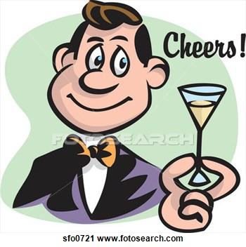
Formalization
The degree to which jobs within the organization are standardized and the extent to which employee behavior is guided by rules and procedures.
Highly formalized jobs offer little discretion over what is to be done.
Low formalization means fewer constraints on how employees do their work.

Slide 20


Organizational Design Decisions
A rigid and tightly controlled structure
Highly flexible and adaptable structure
• High specialization
• Rigid departmentalization
• Clear chain of command
• Narrow spans of control
• Centralization
• High formalization
• Limited information network
• Cross-functional teams
• Cross-hierarchical teams
• Free flow of information
• Wide spans of control
• Decentralization
• Low formalization
• Open communication network

Slide 21
Contingency Factors
Structural decisions are influenced by:
Overall strategy of the organization
Organizational structure follows strategy.
Size of the organization
Firms change from organic to mechanistic organizations as they grow in size.
Technology use by the organization
Firms adapt their structure to the technology they use.
Degree of environmental uncertainty
Dynamic environments require organic structures; mechanistic structures need stable environments.

Slide 22
Common Organizational Designs
Traditional Designs
Simple structure
Low departmentalization, wide spans of control, centralized authority, little formalization
Functional structure
Departmentalization by function
Operations, finance, human resources, and product research and development
Divisional structure
Composed of separate business units or divisions with limited autonomy under the coordination and control the parent corporation.

Slide 23
Common Organizational Designs
Contemporary Designs
Team structures
The entire organization is made up of work groups or self-managed teams of empowered employees.
Matrix- Project structures
Specialists from different functional departments are assigned to work on projects led by project managers.
Matrix structures have two managers.
In dedicated structures, employees work continuously on projects; moving on to another project as each project is completed.

Slide 24
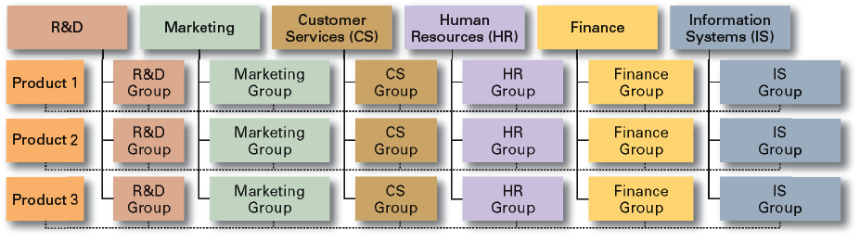
Exhibit 10–9 An Example of a Matrix Organization

Slide 25
Common Organizational Designs
Boundary less Organization
A flexible and unstructured organizational design that is intended to break down external barriers between the organization and its customers and suppliers.
Removes internal (horizontal) boundaries:
Eliminates the chain of command
Has limitless spans of control
Uses empowered teams rather than departments
Eliminates external boundaries:
Uses virtual, and network organizational structures to get closer to stakeholders.

Slide 26

Removing External Boundaries
Virtual Organization
An organization that consists of a small core of full-time employees and that temporarily hires specialists to work on opportunities that arise.

Slide 27
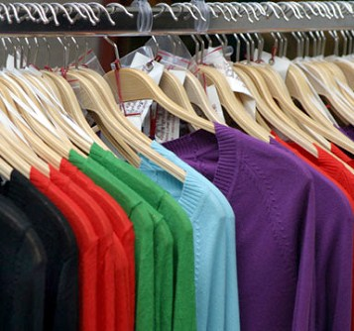
Removing External Boundaries
Network Organization
A small core organization that outsources its major business functions (e.g., manufacturing) in order to concentrate what it does best.

Slide 28
Organizational Designs (cont’d)
The Learning Organization
An organization that has developed the capacity to continuously learn, adapt, and change through the practice of knowledge management by employees.
Characteristics of a learning organization:
An open team-based organization design that empowers employees
Extensive and open information sharing
Leadership that provides a shared vision of the organization’s future, support and encouragement
A strong culture of shared values, trust, openness, and a sense of community.

Slide 29
